Slide 1
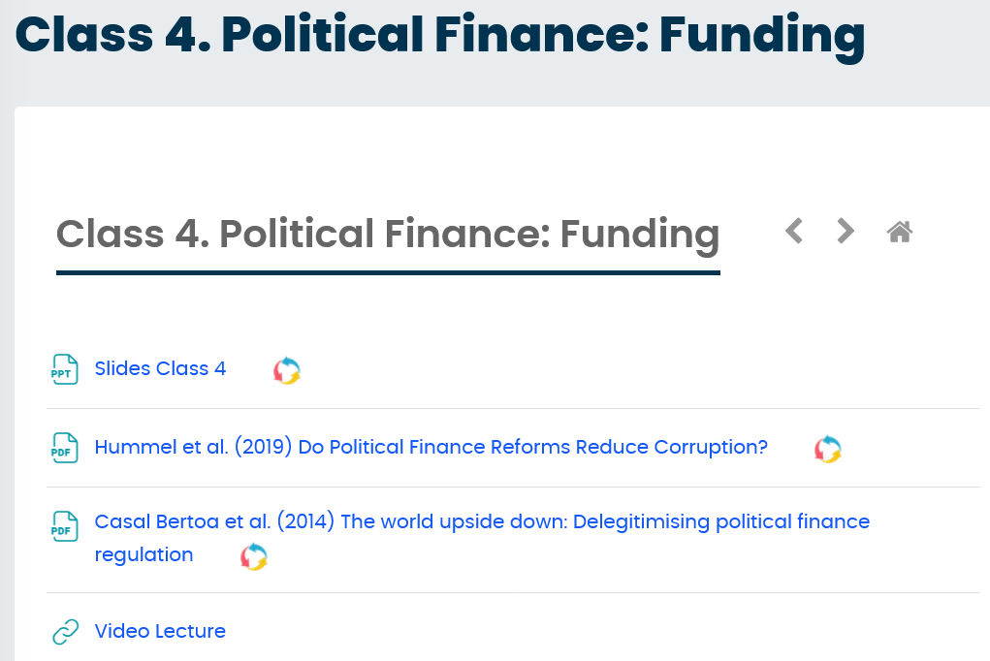
ICYMI: Video Lecture on Loop (link to YT)

Slide 2
Preparation 1 is here!

Slide 3
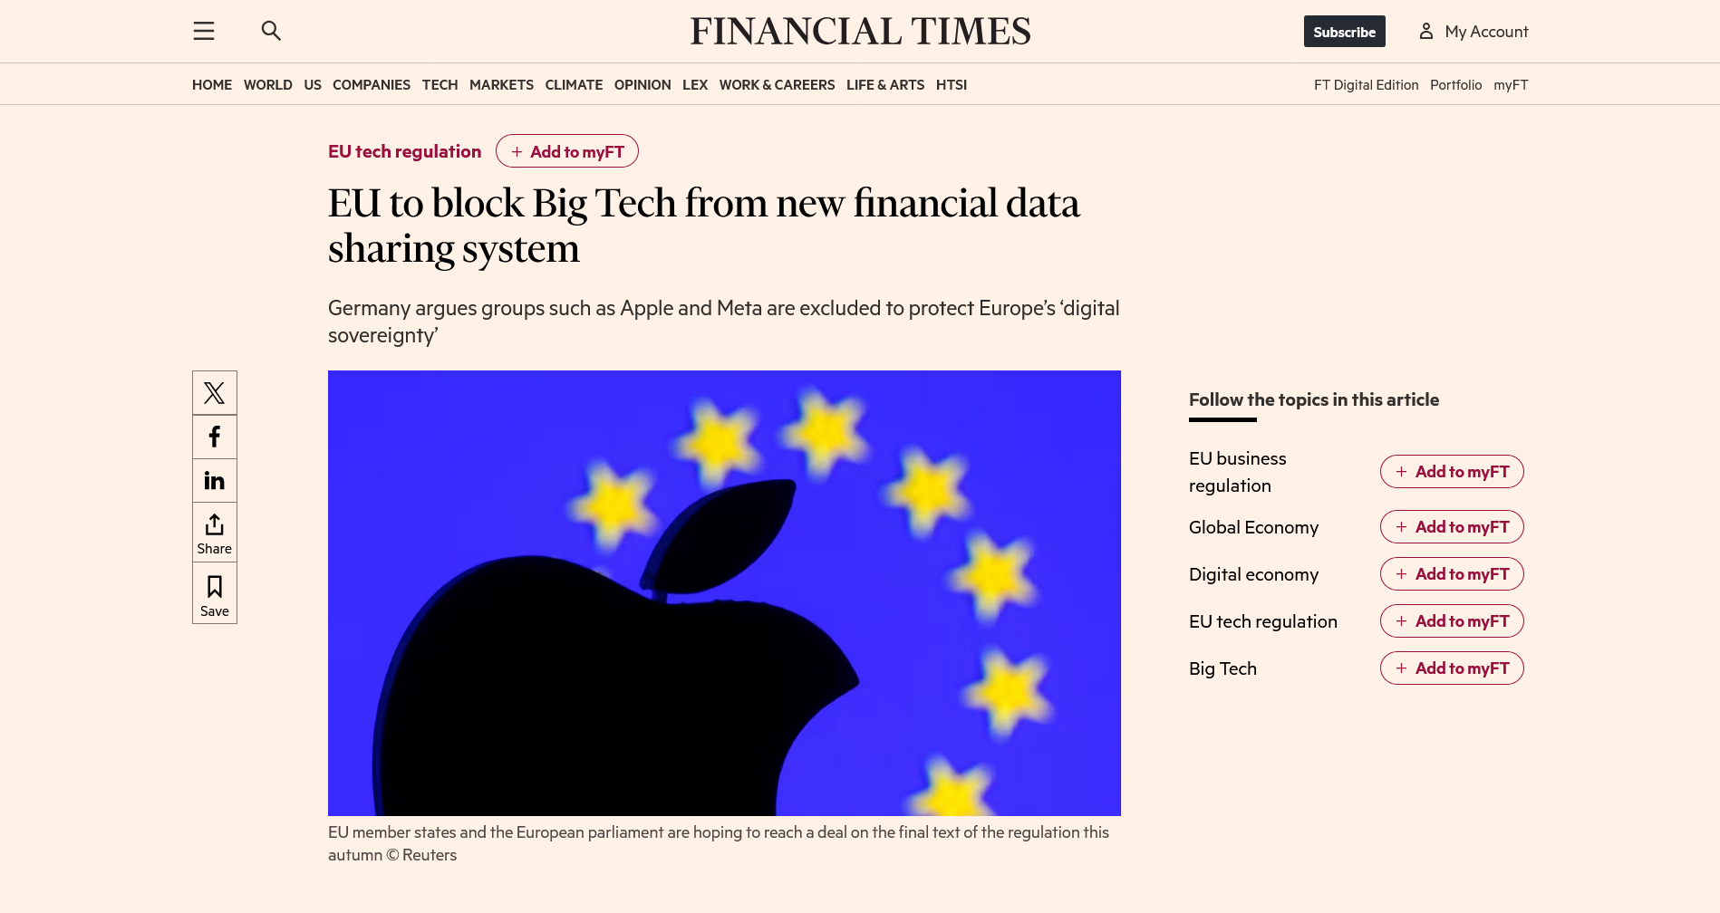
MPD in the News: Brussels’ blow to Big Tech
Source: Financial Times | 21/9/2025

Slide 4
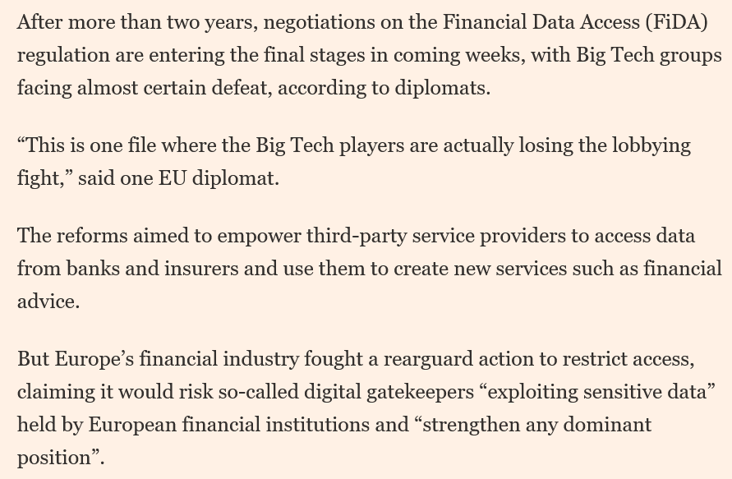
MPD in the News: Brussels’ blow to Big Tech
POWER
Financial Data EU Citizens
META
EU banking Sector lobby
APPLE
GOOGLE
AMAZON
Source: Financial Times | 21/9/2025

Slide 5
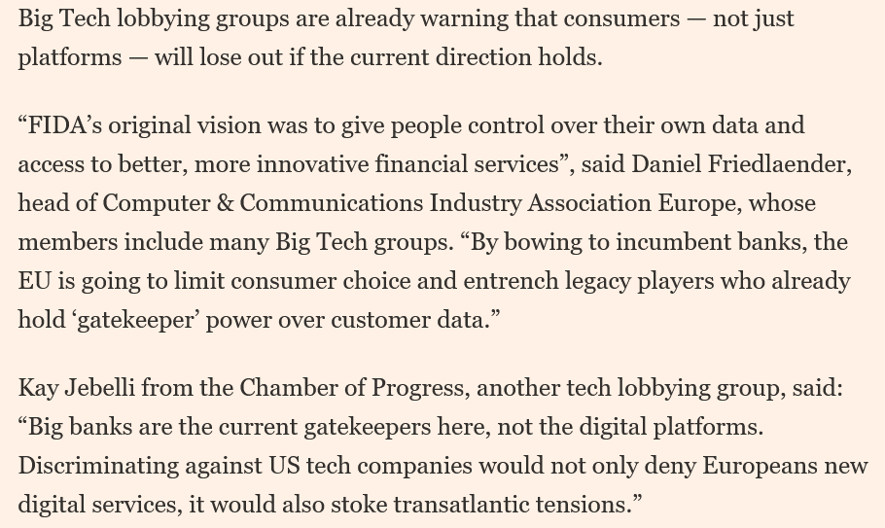
MPD in the News: Brussels’ blow to Big Tech
POWER
META
EU banking Sector lobby
APPLE
GOOGLE
AMAZON
Source: Financial Times | 21/9/2025

Slide 6
POL1050: Money, Power and Democracy
Class 5: Lobbying Inside Out – 22/9/2025

Slide 7
Schedule
This week: Lobbying
Today: Lobbying Inside Out
What is it
Who does it?
How do you do it?
Wednesday: Lobbying & MPD

Slide 8
What is lobbying?
~ Advocacy, Public Affairs, Interest Representation, …
ACTORS WITH
POLICY INTEREST
LOBBY
AUTHORITIES FOR
POLICY OUTCOME
Activities undertaken with the purpose of influencing decisions & policies adopted by public authorities
Indirect path to power

Slide 9
Example: Brussels’ blow to Big Tech
Financial Data EU Citizens
POLICY
META
EU banking Sector lobby
AUTHORITY
APPLE
GOOGLE
ACTORS
AMAZON

Slide 10
Who lobbies?
Technically anyone -> Individual Representation
Often through the use of professional lobby firms
But power relationship creates zero-sum game!
ACTORS WITH
POLICY INTEREST
LOBBY
AUTHORITIES FOR
POLICY OUTCOME

Slide 11
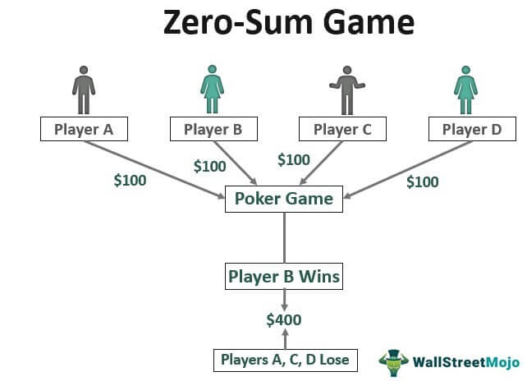
Recap: What is power?
Resource approaches (Weber, Parsons, Mann, Giddens):
Probability of pushing through own will in the face of another’s resistance, regardless of basis of probability (Weber)
Zero-sum game (distributive power)

Slide 12
Who lobbies?
Technically anyone -> Individual Representation
But in struggle for power leads to zero-sum game!
Instead: collective power!
ACTORS WITH
POLICY INTEREST
ORGANIZE
COLLECTIVE
LOBBY
AUTHORITIES FOR
POLICY OUTCOME

Slide 13
Who lobbies?
Technically anyone -> Individual Representation
But often in form of Collective representation
Many different terms:
Interest associations
Pressure groups
Civil society organisations
Organized interests
Citizen Groups
Public interest groups
NGOs
Social movement organisations
Civil society organisations
…
Most common: Interest Groups

Slide 14
What is an interest group?
ACTORS WITH
POLICY INTEREST
ORGANIZE
COLLECTIVE
LOBBY
AUTHORITIES FOR
POLICY OUTCOME
Central idea (Beyers et al. 2008):
Represent collective interests
Engage in collective political advocacy
Without competing in elections (see class on Wednesday)…
but rather by interacting with political decision-makers in the form of lobbying
Examples?

Slide 15
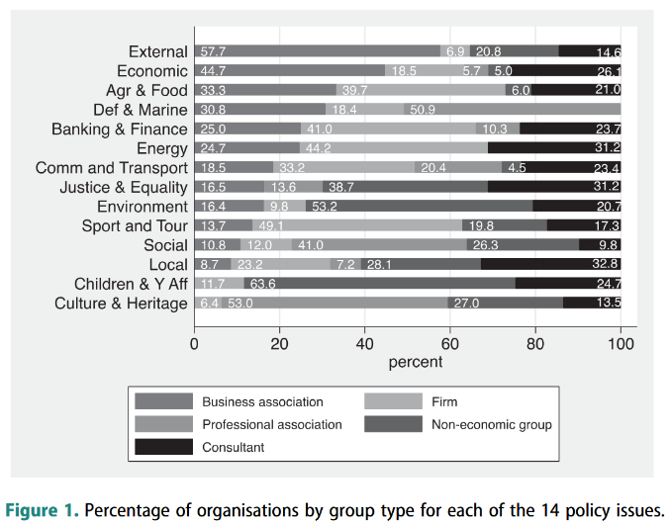
Ireland: over 2000 groups (Crepaz & Chari 2022)

Slide 16
Exercise: Lobbying for Open Book Exam
In an unexpected turn of events, the exam for the module “Money, Power and Democracy” has been switched from open book to closed book. This means that you will be required to actually study the boring material covered during the lectures for the exam.
Naturally, you all want to avoid this.
How would you go about lobbying the school/university for this? What actions would you undertake? Come up with multiple strategies!

Slide 17
Exercise: Lobbying for Open Book Exam
Petitions
Spam emails
Walkouts
Student unions -> partnership
Strike at exam day
Bargaining: easier questions + tips on the exam
Mass tranfer to other module
Meeting with course coordinator

Slide 18
Inside Lobbying
Face-to-face meetings
Emails, letters, advocacy papers
Drafting amendments
Consultations, open hearings
Events
…

Slide 19
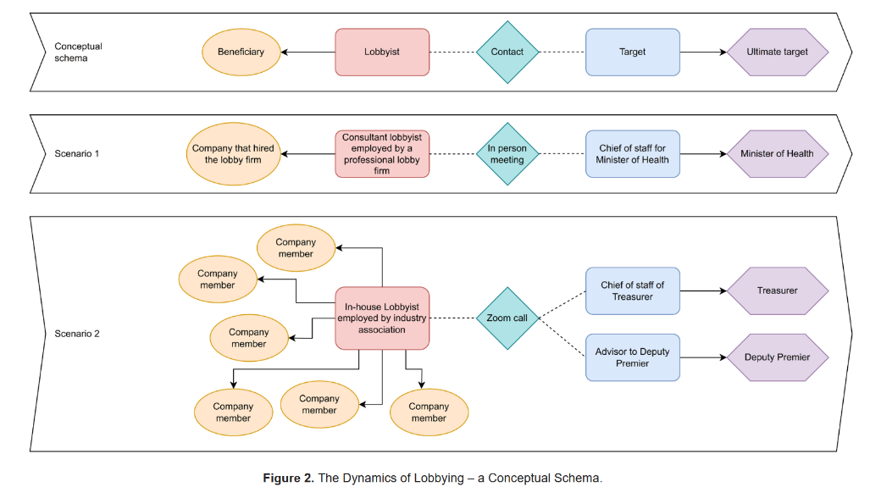
Individual Representation
Collective Representation
Nichols et al. 2024. Lobbying in the Sunlight: A Scoping Review of Frameworks to Measure the Accessibility of Lobbying Disclosures. DOI:10.34172/ijhpm.8497

Slide 20
Outside Lobbying
Press/media engagements
Campaigns, petitions
Grassroots mobilization
Demonstrations
…
But for interest groups: lobbying success vs organizational survival (Beyers et al. 2008)

Slide 21
Conclusion
Lobbying = activities by those with policy interests to convince officials of policy outcomes
Can be done in multiple ways:
Individually
Collectively (Interest Groups)
Inside
Outside
Next class:
What determines success?
What is role of money?
What is effect on democracy?
And what about corruption?

